Slide 1
Videogram
Derek James, Jerry Maldonado, Matt Robles

Slide 2
Videogram
1
4
PROJECT LESSONS LEARNED
WATERFALL ARTIFACTS
2
5
SCRUM ARTIFACTS
CONFIGURATION MANAGEMENT ITEMS AND PRODUCT SOFTWARE LIBRARY
3
6
PRIMARY PRODUCT FEATURES
SOFTWARE ENGINEERING CONCEPTS INCORPORATED

Slide 3
WATERFALL ARTIFACTS
Summary of the waterfall portion of the project including Project Plan, Software Requirements, Design Documentation, and Testing.

Slide 4
WATERFALL ARTIFACTS
PROJECT PLAN
REQUIREMENTS
DESIGN
TESTING

Slide 5
WATERFALL ARTIFACTS
PROJECT PLAN

Slide 6
WATERFALL ARTIFACTS
PROJECT PLAN
Project Overview
The purpose of this project is to develop a media sharing application that allows users to store and share their favorite videos.

Slide 7
WATERFALL ARTIFACTS
PROJECT PLAN
R – Responsible, A – Accountable, Q – Quality Reviewer
Roles and Responsibilities | Jerry | Matt | Derek
Scrum Product Owner | R
Scrum Master/Project Manager |  |  | R
Configuration Manager | Q | R | A
Lead Designer | R | A | Q
System Architect | R | A | Q
Designer and Developer - Database |  |  | R
Designer and Developer - Application | R
Designer and Developer - UI |  | R
Testers | R | R | R

Slide 8
WATERFALL ARTIFACTS
PROJECT PLAN
High Level Tasks
 | Description
Requirement Phase | All requirements written.
Design Phase | Design documents written and systems architecture defined.
Development Phase | All software development completed.
Sprint #1 | Sprint #1 Deliverable
Initial Database Creation | Database system created and setup to requirement and design specifications.
Initial Application Creation | Back end application created and setup to requirement and design specifications.
Initial UI Creation | User interface created and setup to requirement and design specifications.

Slide 9
WATERFALL ARTIFACTS
PROJECT PLAN
High Level Tasks
Sprint #2 | Sprint #2 Deliverable
All Main Database Features Added | All main database functionality/features implemented.
All Main Application Features Added | All main database functionality/features implemented.
All Main UI Features Added | All main user interface functionality/features implemented.
Sprint #3 | Sprint #3 Deliverable
Final Touches Database Features | Final touches to any extra database functionality/features database to back end application interface implementation
Final Touches Application Features | Final touches to any extra back end application functionality/features back end application to database interface implementation back end application to UI interface implementation

Slide 10
WATERFALL ARTIFACTS
PROJECT PLAN
High Level Tasks
Final Touches UI Features | Final touches to any extra UI functionality/features UI to back end application interface implementation
Testing Phase | All test cases executed, documented, and verified.
Launch | Final Project Deliverable.

Slide 11
WATERFALL ARTIFACTS
PROJECT PLAN
Assignments
 | Assignment
Requirement Phase | Jerry/Matt/Derek
Design Phase | Jerry/Matt/Derek
Development Phase | Jerry/Matt/Derek
Sprint #1 | Jerry/Matt/Derek
Initial Database Creation | Derek
Initial Application Creation | Jerry
Initial UI Creation | Matt

Slide 12
WATERFALL ARTIFACTS
PROJECT PLAN
Assignments
Sprint #2 | Jerry/Matt/Derek
All Main Database Features Added | Derek
All Main Application Features Added | Jerry
All Main UI Features Added | Matt
Sprint #3 | Jerry/Matt/Derek
Final Touches Database Features | Derek
Final Touches Application Features | Jerry

Slide 13
WATERFALL ARTIFACTS
PROJECT PLAN
Assignments
Final Touches UI Features | Matt
Testing Phase | Jerry/Matt/Derek
Launch | Jerry/Matt/Derek

Slide 14
WATERFALL ARTIFACTS
PROJECT PLAN
REQUIREMENTS

Slide 15
WATERFALL ARTIFACTS
PROJECT PLAN
REQUIREMENTS
Requirements Overview
The product being developed is a software application that should allow users to easily share videos with friends. The product should utilize three main software components, being a database, back end application, and front-end UI.

Slide 16
WATERFALL ARTIFACTS
PROJECT PLAN
REQUIREMENTS
Product Features
Main features shall include:
User Authentication
Video Sharing
Video Viewing

Slide 17
WATERFALL ARTIFACTS
PROJECT PLAN
REQUIREMENTS
Functional Requirements
The software shall require a user account for any operation.
The software shall require user authentication upon startup.
The software shall provide an option allowing a user to find other users.
The software shall provide an option allowing a user to share a video.
The software shall store any video that is uploaded by a user.
The software shall present any videos of any specified user.

Slide 18
WATERFALL ARTIFACTS
PROJECT PLAN
REQUIREMENTS
Main System Interfaces
The database shall interface with the application responding to any SQL queries sent.
The application shall interface with the front-end UI using HTTP communication protocol.

Slide 19
WATERFALL ARTIFACTS
PROJECT PLAN
REQUIREMENTS
DESIGN

Slide 20
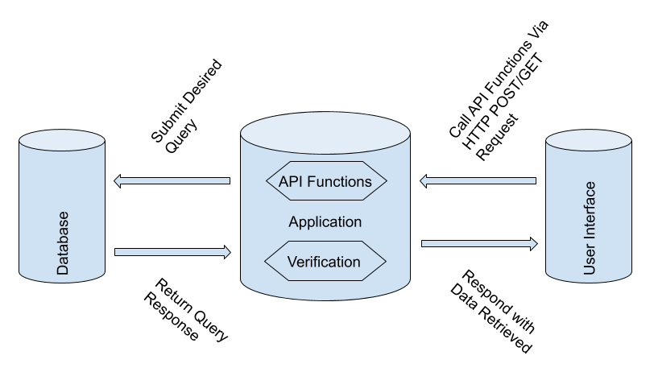
WATERFALL ARTIFACTS
PROJECT PLAN
REQUIREMENTS
DESIGN
System Architecture

Slide 21
WATERFALL ARTIFACTS
PROJECT PLAN
REQUIREMENTS
DESIGN
User Interface Component Details
Built for android mobile devices.
Developed in android studio.

Slide 22
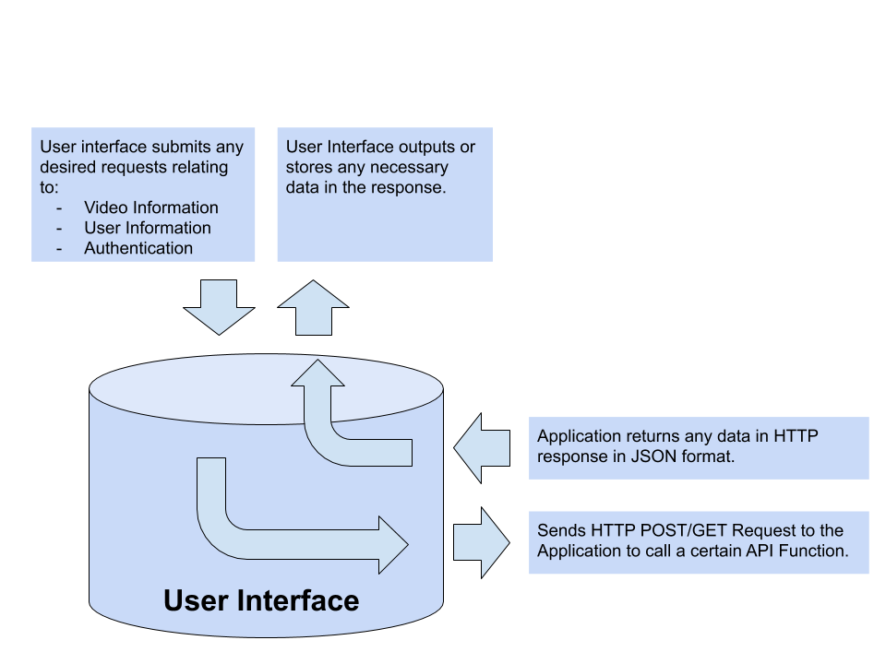
WATERFALL ARTIFACTS
PROJECT PLAN
REQUIREMENTS
DESIGN
User Interface Component

Slide 23
WATERFALL ARTIFACTS
PROJECT PLAN
REQUIREMENTS
DESIGN
User Interface Upload Operation
User Interface component interfaces with an AWS service called S3 (Cloud file storage).
User Interface component utilizes an AWS provided API to upload a file to cloud storage.
URL is then stored in the Videogram Database.

Slide 24
WATERFALL ARTIFACTS
PROJECT PLAN
REQUIREMENTS
DESIGN
Application Component Details
Developed with Node.js and implemented as a REST API.
Runs on a virtual server hosted with Amazon Web Services.
Listens for any HTTP POST/GET Requests on a specified port.
Utilizes a MySQL module available in Node.js that acts as a MySQL client giving the ability to establish a connection and submit SQL statements to a MySQL database.

Slide 25
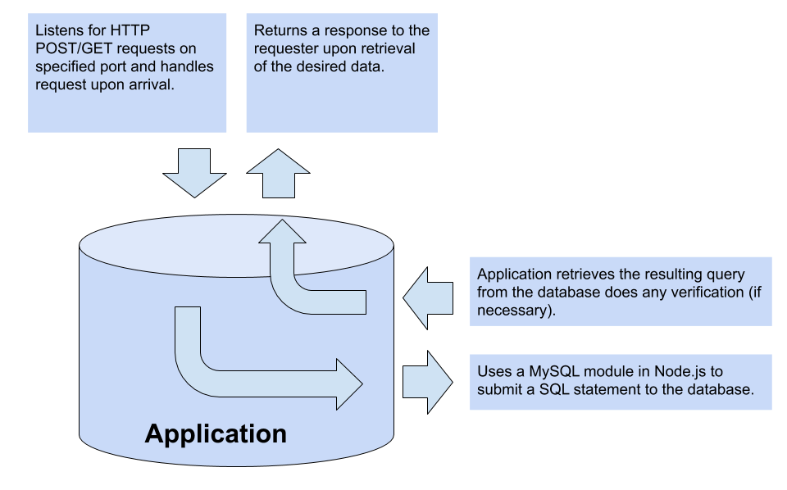
WATERFALL ARTIFACTS
PROJECT PLAN
REQUIREMENTS
DESIGN
Application Component

Slide 26
WATERFALL ARTIFACTS
PROJECT PLAN
REQUIREMENTS
DESIGN
Database Component Details
MySQL database.
Hosted with Amazon Web Services.

Slide 27
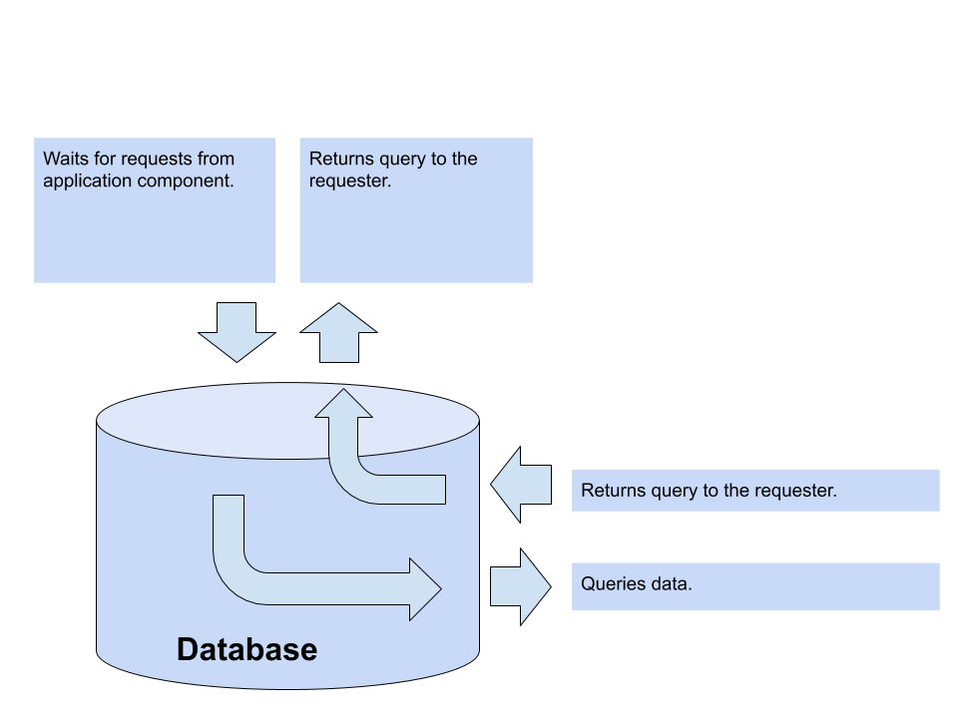
WATERFALL ARTIFACTS
PROJECT PLAN
REQUIREMENTS
DESIGN
Database Component

Slide 28
WATERFALL ARTIFACTS
PROJECT PLAN
REQUIREMENTS
DESIGN
TESTING

Slide 29
WATERFALL ARTIFACTS
PROJECT PLAN
REQUIREMENTS
DESIGN
TESTING
Test Approach
The testing approach that will be taken is one that utilizes an automated testing framework to perform unit tests that verify single component level requirements and system requirements including:
Unit tests against the back end server application component.
Unit tests against the database component.
Integration tests against all system interfaces.
* UI Requirements that need testing will also be done with manual observations.

Slide 30
WATERFALL ARTIFACTS
PROJECT PLAN
REQUIREMENTS
DESIGN
TESTING
Test Plan
All features that are implemented must be tested including:
User signup
User login
Video uploads
Video likes
Video comments
Find users

Slide 31
WATERFALL ARTIFACTS
PROJECT PLAN
REQUIREMENTS
DESIGN
TESTING
Testing Tools and Environment
The testing framework that will be used for automated testing is mocha-js. This testing framework allows for unit testing of application, database, and system interfaces.

Slide 32
WATERFALL ARTIFACTS
PROJECT PLAN
REQUIREMENTS
DESIGN
TESTING
Requirements Traceability
Req Type | Req ID. | Description | Test Covered
External Interface Requirement | 21101 | The user interface shall be user friendly, simplistic, familiar, and pleasing to look at. | Manual Observation
 | 21300 | The database shall utilize AWS for database hosting. | TC 1-44
 | 21301 | The database shall interface with the back-end application by responding to SQL requests. | TC 1-44
 | 21302 | The back-end application shall interface with the front-end UI. | Manual Observation
 | 21400 | The back-end application shall utilize the Node.js module to interface with the database. | TC 1-44

Slide 33
WATERFALL ARTIFACTS
PROJECT PLAN
REQUIREMENTS
DESIGN
TESTING
Requirements Traceability
Req Type | Req ID. | Description | Test Covered
 | 21401 | The back-end application shall submit SQL statements to query data from the database. | TC 1-44
Functional Requirement | 22200 | The software shall require a user account for any operation. | TC 1, 2
 | 22201 | The software shall require user authentication. | TC 5, 6
 | 22202 | The software shall provide an option allowing a user to find other users. | TC 43, 44
 | 22203 | The software shall provide an option allowing a user to share a video. | TC 12

Slide 34
WATERFALL ARTIFACTS
PROJECT PLAN
REQUIREMENTS
DESIGN
TESTING
Requirements Traceability
Req Type | Req ID. | Description | Test Covered
 | 22204 | The software shall store any video that is uploaded by a user. | TC 12
 | 22205 | The software shall present any videos of any specified user. | TC 16
Reliability Requirement | 23100 | Extremely minimal application crashing. | Manual Observation
 | 23101 | Minimal latency between backend and front-end. | Manual Observation
Availability Requirement | 23200 | The software shall be available for android devices only. | Manual Observation

Slide 35
WATERFALL ARTIFACTS
PROJECT PLAN
REQUIREMENTS
DESIGN
TESTING
Requirements Traceability
Req Type | Req ID. | Description | Test Covered
Security Requirement | 23300 | The software shall ONLY collect the following personal data: - Username - Password - Email - Full Name | TC 1, 2
 | 23301 | The software shall not use any personal data collected for a user outside of the scope of the application. | TC 2
 | 23304 | The software shall not use any uploaded photos/videos for a user outside of the scope of the application. | TC 12

Slide 36
WATERFALL ARTIFACTS
PROJECT PLAN
REQUIREMENTS
DESIGN
TESTING
Requirements Traceability
Req Type | Req ID. | Description | Test Covered
Portability Requirement | 23500 | The software shall run on AndroidOS. | Manual Observation
Database Requirement | 24000 | The database shall be set up so that no anomalies exist. | TC 1 - 44
 | 24001 | The database shall store the following user personal data: - Username - Password - Email - Full Name | TC 1, 2

Slide 37
WATERFALL ARTIFACTS
PROJECT PLAN
REQUIREMENTS
DESIGN
TESTING
Requirements Traceability
Req Type | Req ID. | Description | Test Covered
 | 24002 | The database shall store links to the following user media data: - Uploaded Videos | TC 11, 12, 15, 16
 | 24003 | The database may store the following user uploaded video data: - Description - Location - Date - Tags - Length - Quality - Likes - Comments | TC 11, 12

Slide 38
SCRUM ARTIFACTS
Summary of sprint tracking through the Scrum portion of the project, including, Finalized product backlog and project burndown chart.

Slide 39
SCRUM ARTIFACTS
PRODUCT BACKLOG
BURNDOWN CHARTS

Slide 40
SCRUM ARTIFACTS
PRODUCT BACKLOG

Slide 41
SCRUM ARTIFACTS
PRODUCT BACKLOG
 | Item # | Story | Est/ Act | By
Very High
Complete | 1 | Implement all system interfaces. | 9/9 | MR/JM/DJ
Complete | 2 | Implement all necessary database tables. | 3/2 | DJ
Complete | 3 | As an unauthorized user, I must be able to create an account. | 10/14 | MR/JM/DJ
Complete | 4 | As an authorized user, I must be able to log in. | 6/7 | MR/JM/DJ
Complete | 5 | As an authorized user, I must be able to log out. | 6/6 | MR/JM/DJ
Complete | 6 | As an authorized user, I must be able to upload a profile picture. | 15/8 | MR/JM/DJ
Complete | 7 | As an authorized user, I must be able to upload a video. | 60/80 | MR/JM/DJ
Complete | 8 | As an authorized user, I must be able to delete an uploaded video. | 20/11 | MR/JM/DJ
Complete | 9 | As an authorized user, I must be able to find other users. | 20/17 | MR/JM/DJ
Complete | 11 | As an authorized user, I must be able to navigate between all pages. | 6/10 | MR

Slide 42
SCRUM ARTIFACTS
PRODUCT BACKLOG
High
Complete | 12 | As an authorized user, I should be able to like other peoples videos and my videos. | 6/5 | MR/JM/DJ
Complete | 13 | As an authorized user, I should be able to comment on other peoples videos and my videos. | 4/7 | MR/JM/DJ
Complete | 14 | As an authorized user, I should be able to view a list of all the comments to any video I have access to. | 6/6 | MR/JM/DJ
Not Completed | 15 | As an authorized user, I should be able to talk to another user through messages,and see all my different conversations. | 30 | MR/JM/DJ
Not Completed | 16 | As an authorized user, I should be able to delete any conversation I have with another user. | 10 | MR/JM/DJ

Slide 43
SCRUM ARTIFACTS
PRODUCT BACKLOG
Medium
Not Completed | 17 | As an authorized user, I should be able to view all activity about my uploaded videos. | 12 | MR/JM
Not Completed | 18 | As an authorized user, I should have the option to make my account private or public. | 6 | MR/JM/DJ
Not Completed | 19 | As an authorized user, I should be able to dislike a video. | 4 | MR/JM/DJ
Not Completed | 20 | As an authorized user, I should be able to change my username. | 3 | MR/JM/DJ
Not Completed | 21 | As an authorized user, I should be notified when someone likes, follows, mentions, or comments on an uploaded video. | 15 | MR
Not Completed | 22 | As an authorized user, I should be able to change my password. | 3 | MR/JM/DJ

Slide 44
SCRUM ARTIFACTS
PRODUCT BACKLOG
BURNDOWN CHARTS

Slide 45
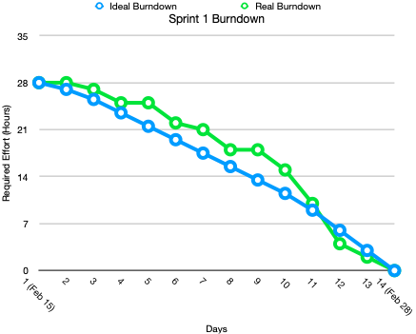
SCRUM ARTIFACTS
PRODUCT BACKLOG
BURNDOWN CHARTS

Slide 46
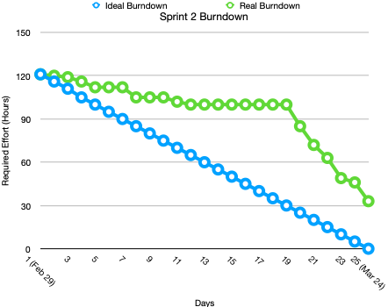
SCRUM ARTIFACTS
PRODUCT BACKLOG
BURNDOWN CHARTS

Slide 47
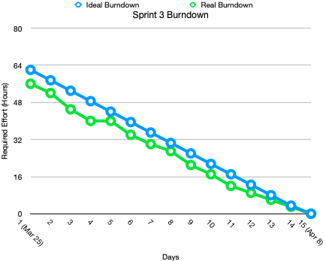
SCRUM ARTIFACTS
PRODUCT BACKLOG
BURNDOWN CHARTS

Slide 48
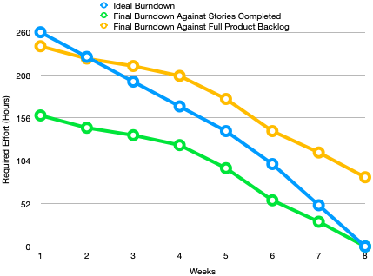
SCRUM ARTIFACTS
PRODUCT BACKLOG
BURNDOWN CHARTS

Slide 49
SOFTWARE ENGINEERING CONCEPTS INCORPORATED
Summary of Software Engineering Concepts incorporated including Software Engineering Management, Life Cycles, Configuration Management, Processes, Models and Quality.

Slide 50
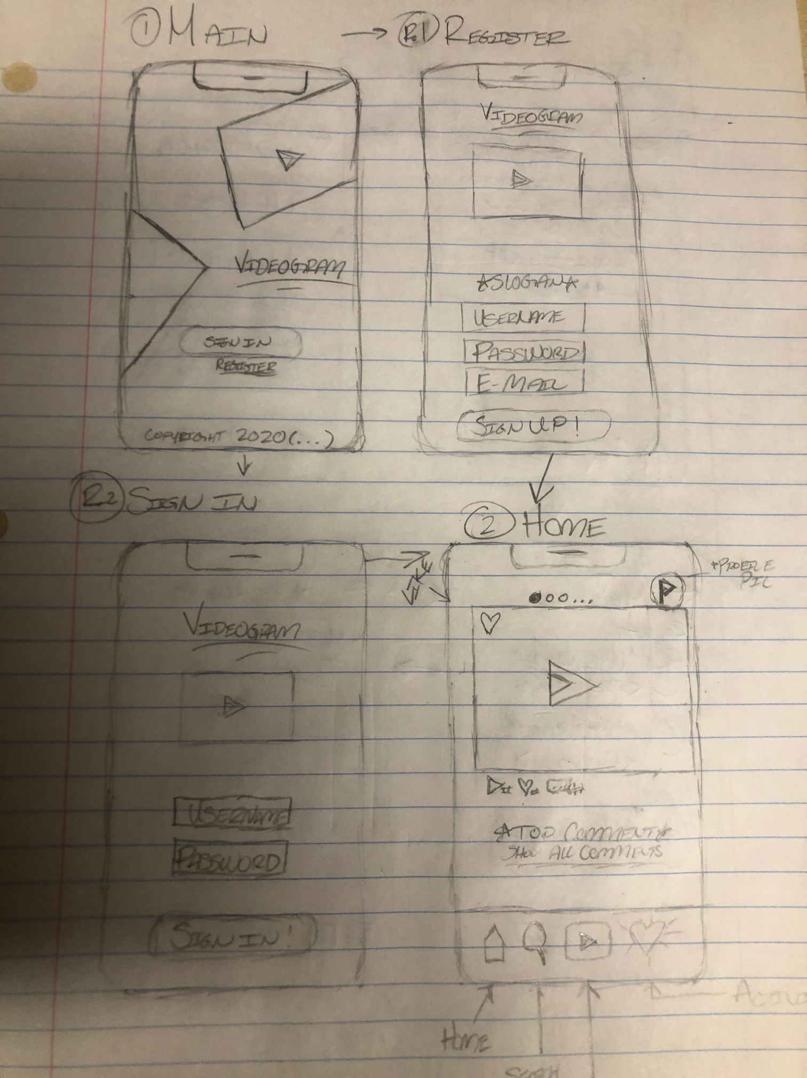
SOFTWARE ENGINEERING CONCEPTS
UI Design
High level design layouts

Slide 51
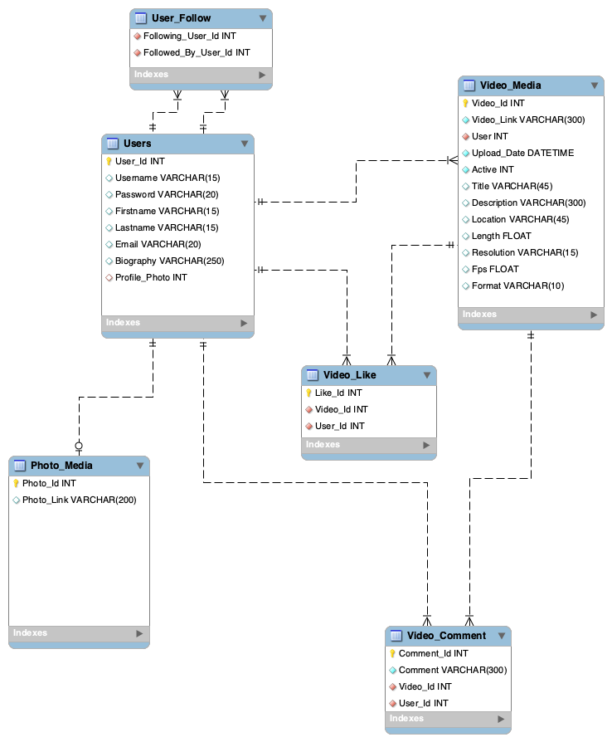
SOFTWARE ENGINEERING CONCEPTS
Database EER Diagram

Slide 52
SOFTWARE ENGINEERING CONCEPTS
Configuration Management
Application program stored in github to control changes and maintain software integrity.
UI program stored in github to control changes and maintain software integrity.
Extensive Application API Documentation for ease of use.

Slide 53
PROJECT LESSONS LEARNED
Summary of Project Lessons Learned including Project Management, Communication, Timelines and Estimations.

Slide 54
PROJECT LESSONS LEARNED
Project Management
Importance of controlling changes with configuration management due to many frequent changes.
Over estimate effort due to unseen roadblocks.
Make sure to have back up plans

Slide 55
PROJECT LESSONS LEARNED
Communication
Lesson learned better to over communicate in times of remote work due to communication issues encountered.

Slide 56
PROJECT LESSONS LEARNED
Timelines and Estimations
Attempted to not underestimate all stories.
Most stories were finished under expected time, with exception of a few.
Possibility of stories not getting completed due to unseen roadblocks.

Slide 57
CONFIGURATION MANAGEMENT ITEMS AND PRODUCT SOFTWARE LIBRARY
Summary of Configuration Management Items in Product Software Library.

Slide 58
CONFIGURATION MANAGEMENT ITEMS AND PRODUCT SOFTWARE LIBRARY
Configuration Management Items
Application program stored in github to control changes and maintain software integrity.
UI program stored in github to control changes and maintain software integrity.
Tests stored in github to control changes.
All documentation and relevant resources stored in google drive.

Slide 59
PRIMARY PRODUCT FEATURES
Screenshots of Primary Product Features.

Slide 60
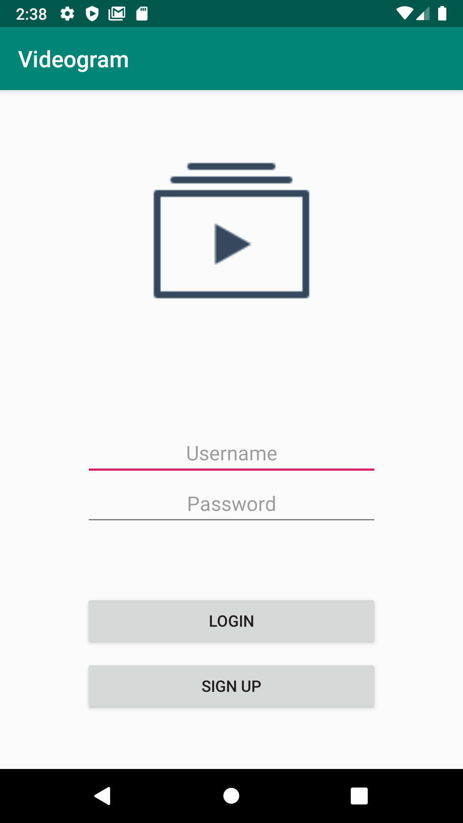
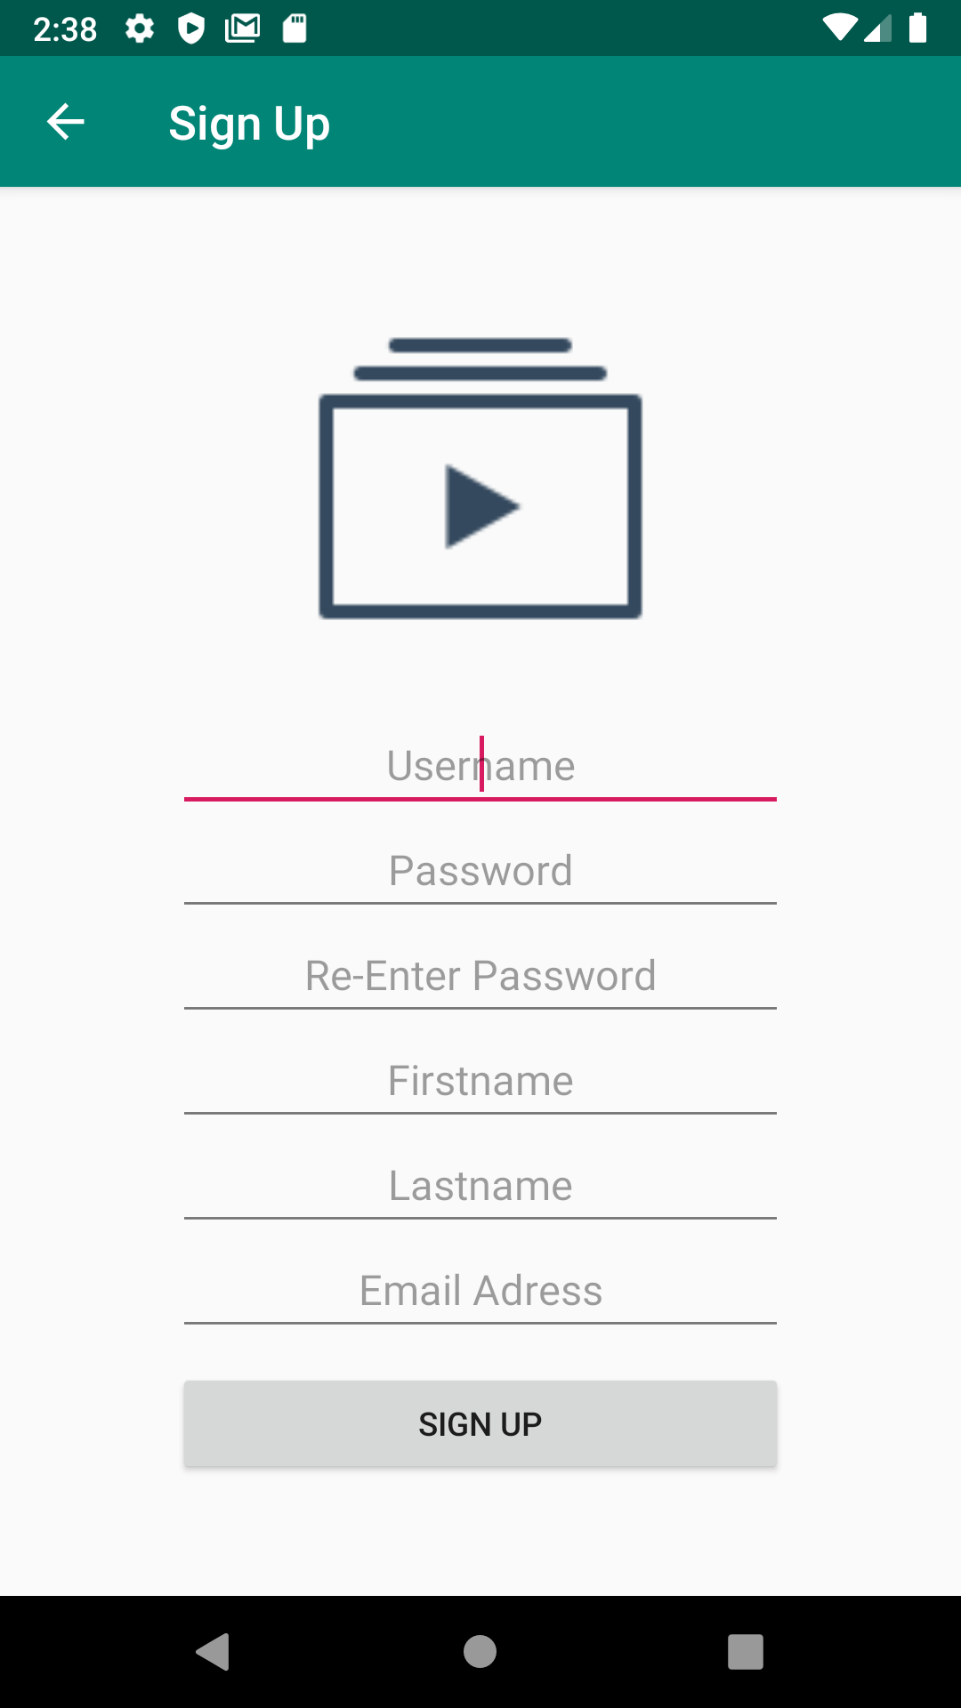
PRIMARY PRODUCT FEATURES

Slide 61
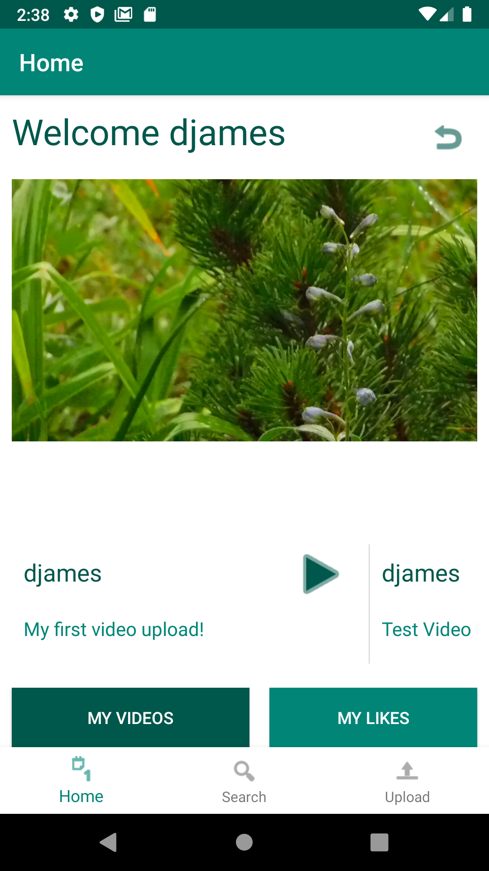
PRIMARY PRODUCT FEATURES

Slide 62
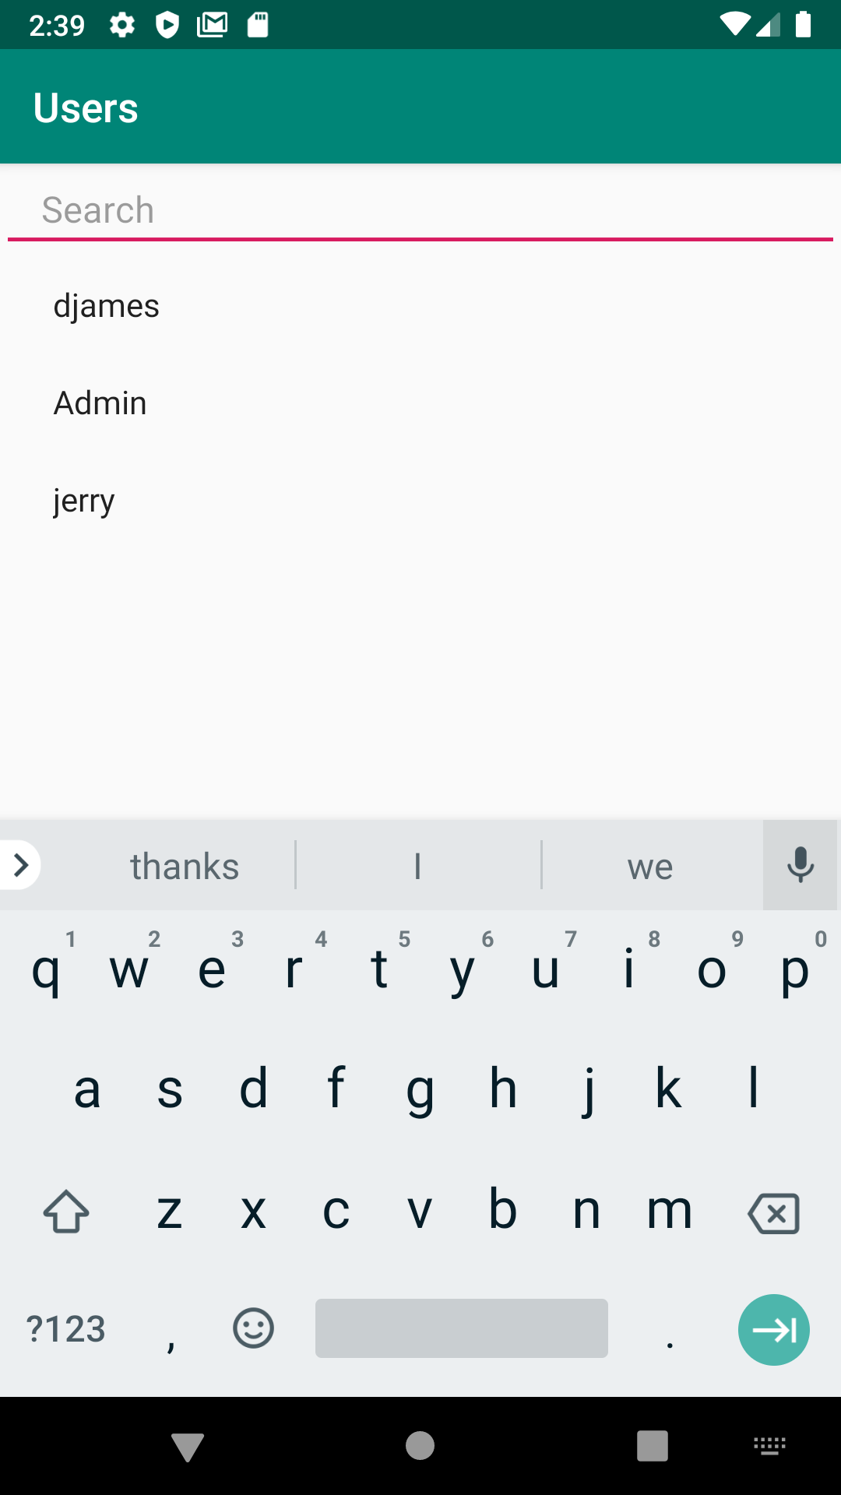
PRIMARY PRODUCT FEATURES

Slide 63
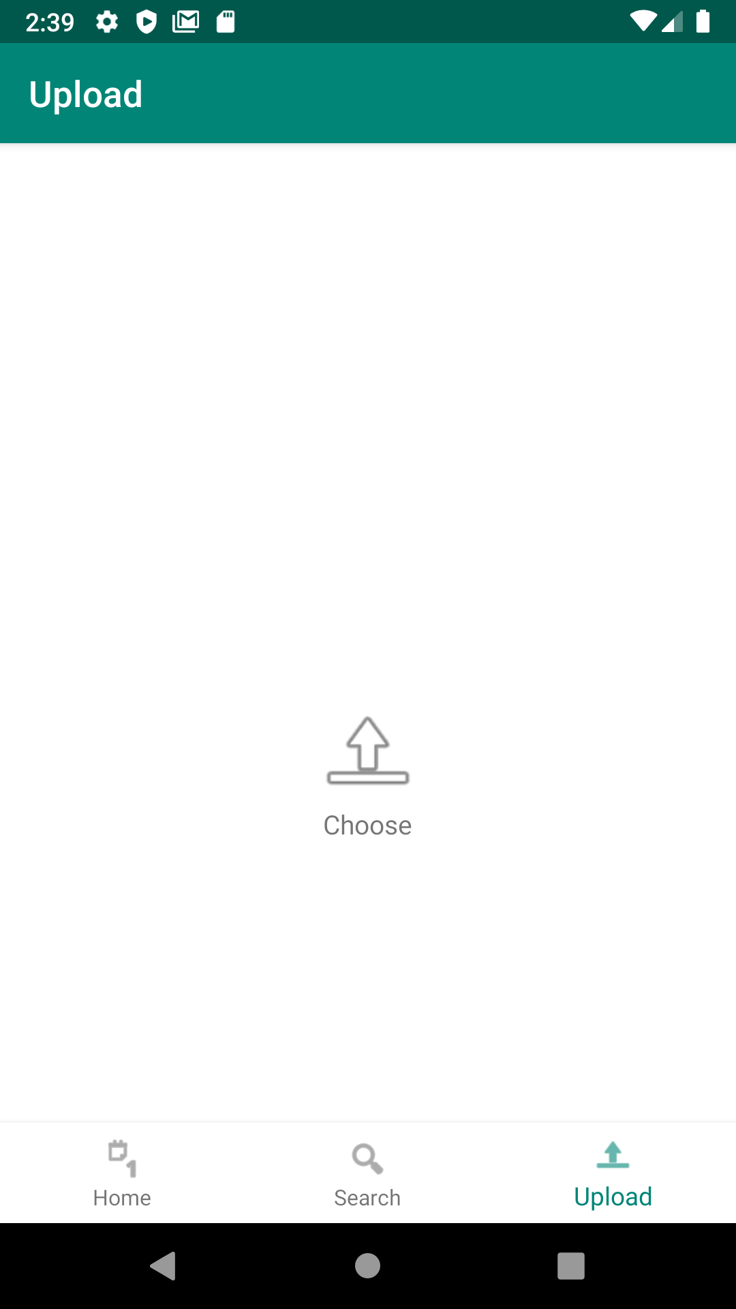
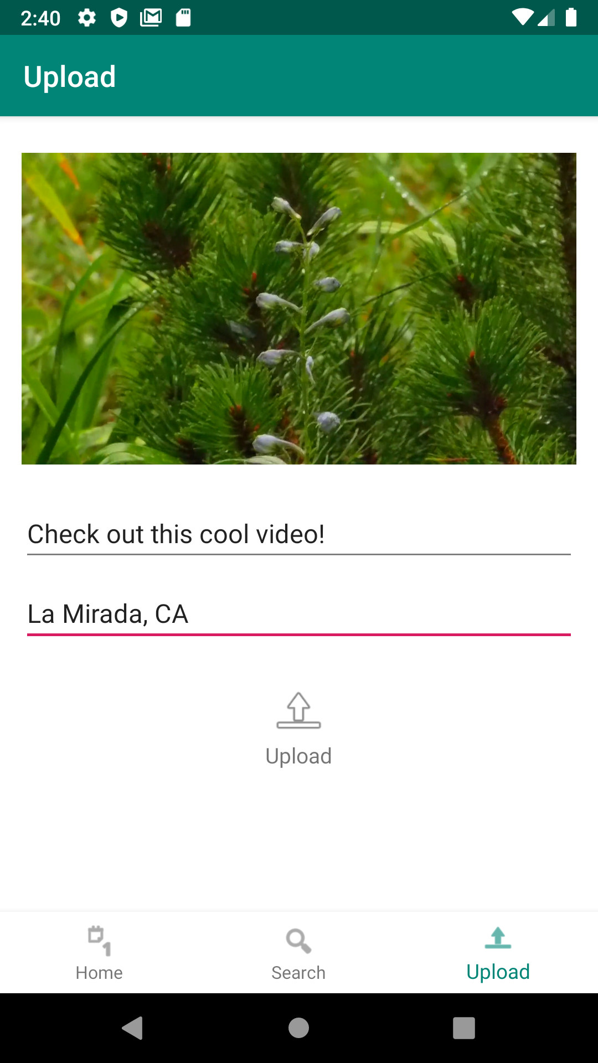
PRIMARY PRODUCT FEATURES

Slide 64
DEMO

